Slide 1
RED Dialogue Progress Update

Slide 2
Methodology
REM of Dialog Data
Treat the sequence of each conversation as a timestamp
Treat the speaker and the subsequent speaker respectively as the sender and the receiver
Encoded the gender and the dialogue act type of the sender and receiver
Individual Analysis
Comparative Analysis
Relational Event Modeling (REM)

Slide 3
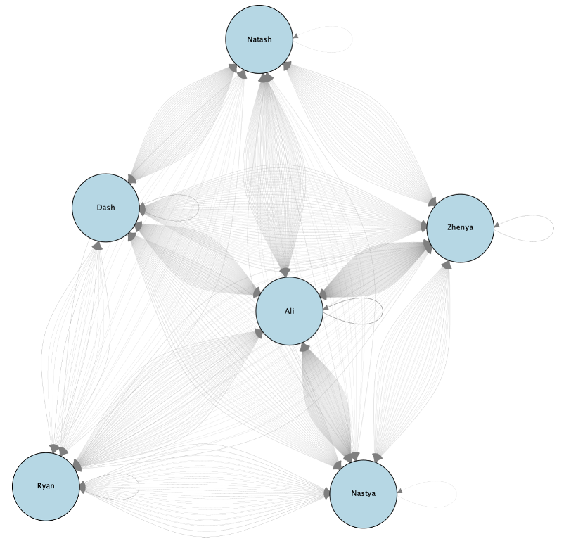
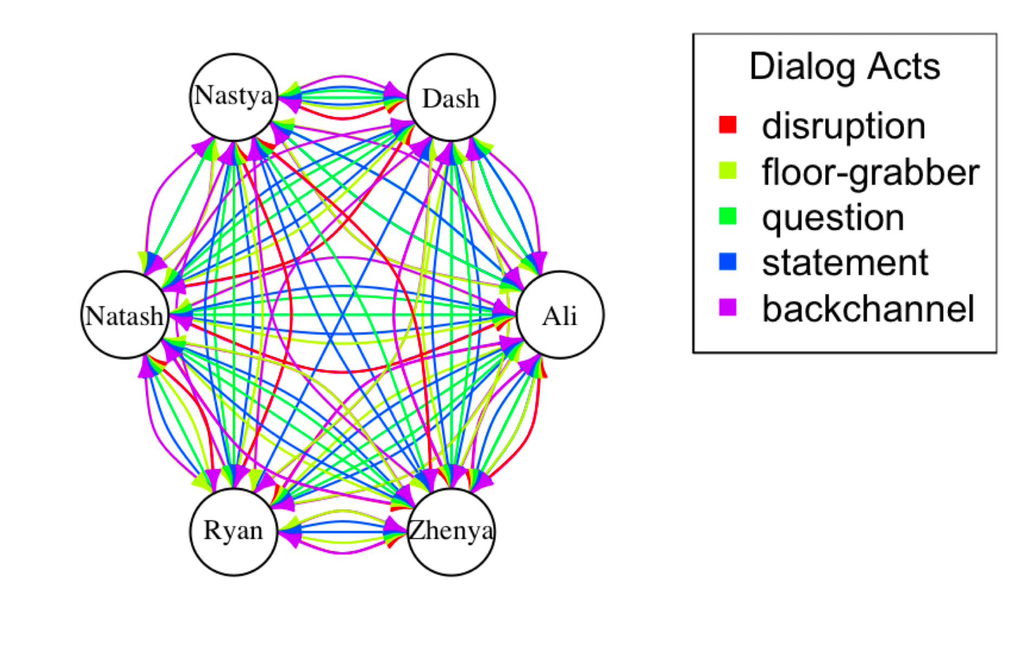
Dialog Act Visualization of NEK 19 Session 3

Slide 4
Model 1
Examine the propensity for reciprocal and repeated interactions within teams.
Key Variables:
RRecSnd (Reciprocal Sending)
RSndSnd (Repeated Sending).
Key Effect: the role of reciprocity and repetitive communication in MTS communication
Model 2: Centrality of Receivers
Incorporate the centrality of communication receivers within the network.
Key Variables:
NTDegRec (Normalized Total Degree Received) assesses centrality of team members in receiving communications.
Key Effect:
Central figures in communication networks play a pivotal role in effective information dissemination, crucial for high team performance.

Slide 5
Model 3: Gender Congruence in Communication
Impact of gender congruence on team communication and performance.
Key Variables:
same_gender reflects if matching sender and receiver gender influences communication dynamics.
SameConstGender assesses the effect of gender congruence
Key Effect
While gender congruence adds an interesting layer to communication analysis, it is not consistently statistically significant.
Model 4: Centrality of Receivers
How do dialogue act types of senders and receivers affect team performance?
Key Variables:
SndDialog & RecDialog to evaluate the influence of specific types of dialogues initiated and received.
Key Effect:
Certain dialogue act types are more prevalent in high-performing teams, indicating that the quality and

Slide 6
Insights from REM Analysis

Slide 7
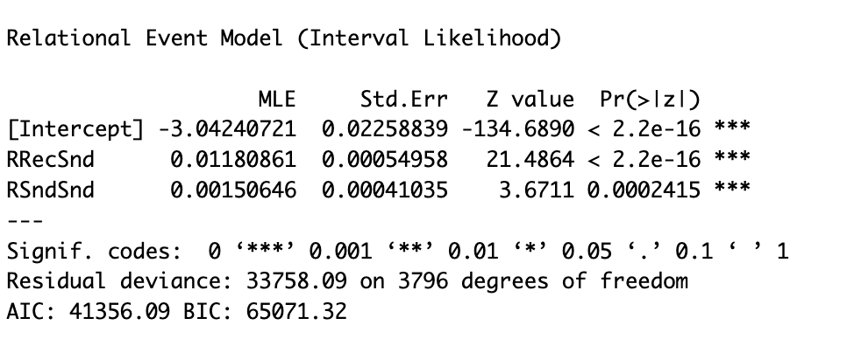
Model 1
RRecSnd: A positive coefficient and a extremely small p-value of suggests strong evidence for the positive effect of reciprocity.
RSndSnd: The positive coefficient and extremely small p-value indicates the tendency for people to repeatedly interact with the same people is statistically significant.
RRecSnd (Reciprocal Sending) captures the effect of reciprocity.
RSndSnd (Repeated Sending) captures the tendency of one member to repeatedly talk to the same person.

Slide 8
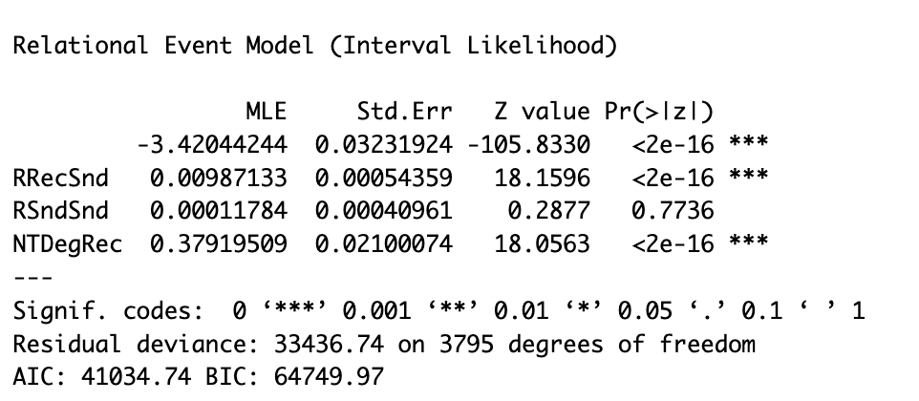
Model 2
RRecSnd remains statistically significant, but not RSndSnd.
While the likelihood of individual i talking to individual j significantly increases if individual j has recently communicated with individual i, we cannot say that individual i is more likely to talk to individual j based solely on i's past behavior of talking to j, holding other factors constant.
NTDegRec (Normalized Total Degree Received) reflects a preference for engaging with individuals perceived as more prominent or influential.

Slide 9
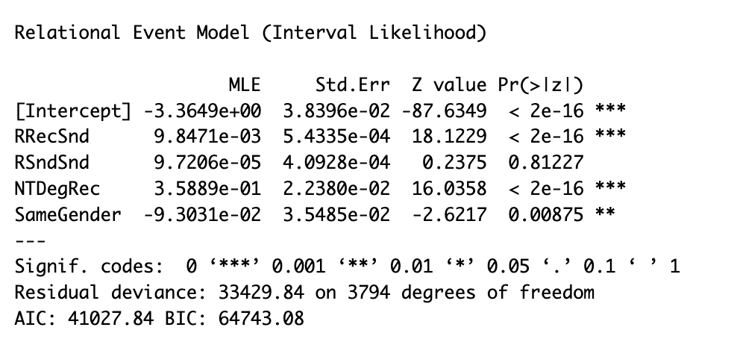
Model 3
RRecSnd remains statistically significant, but not RSndSnd.
While the likelihood of individual i talking to individual j significantly increases if individual j has recently communicated with individual i, we cannot say that individual i is more likely to talk to individual j based solely on i's past behavior of talking to j, holding other factors constant.
NTDegRec (Normalized Total Degree Received) reflects a preference for engaging with individuals perceived as more prominent or influential.

Slide 10
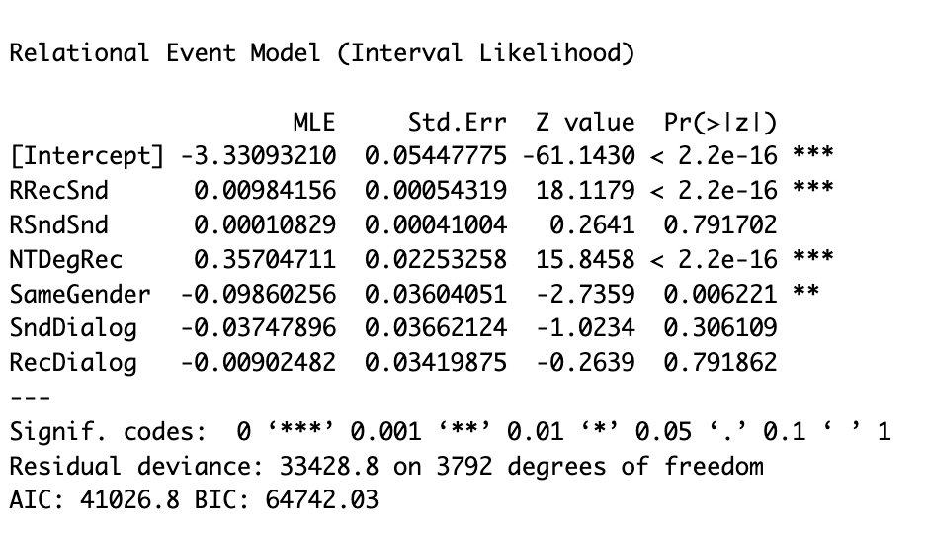
Model 4 (Low)
A strong positive effect of reciprocal sending (RRecSnd), implying that past interactions increase the likelihood of future interactions.
No significant effect from repeated sending (RSndSnd), suggesting no tendency to repeatedly communicate with the same individuals.
A substantial positive effect from normalized total degree received (NTDegRec), indicating the importance of central receivers in the network.
A significant negative effect from gender congruence (SameGender), contrasting with the non-significant gender effect in high-performing sessions.

Slide 11
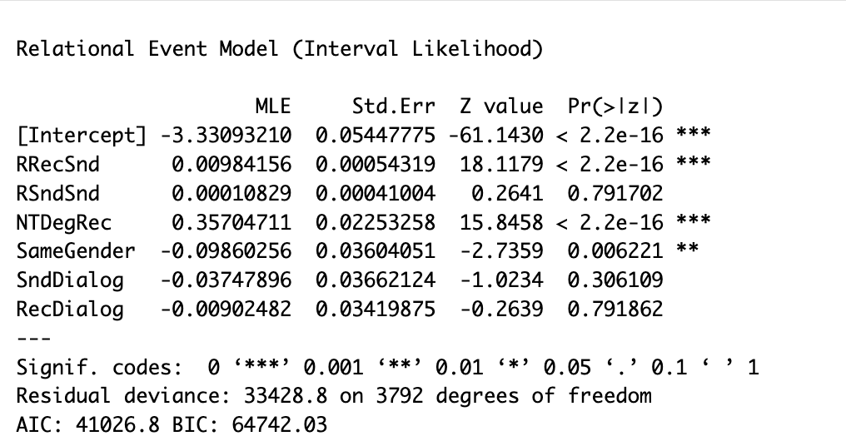
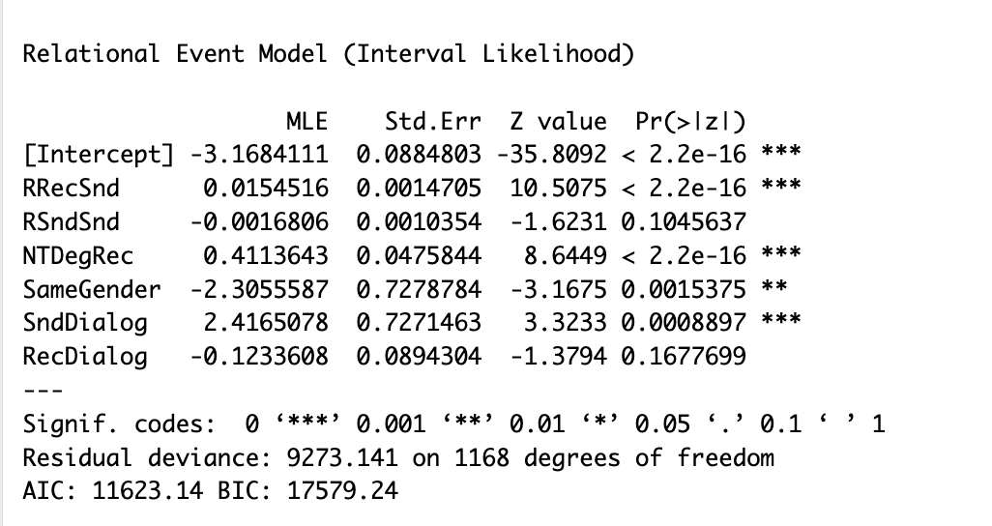
Comparison between low-performing (left) and high-performing (right) sessions

Slide 12
Comparison
Reciprocal Sending (RRecSnd) is significant in both, but the coefficient is slightly higher for low-performing teams.
Repeated Sending (RSndSnd) is not significant in either group.
Normalized Total Degree Received (NTDegRec) is highly significant for both, with a slightly higher coefficient for high-performing sessions, indicating a more pronounced centrality in their communication patterns.
Same Gender (SameGender) is negatively significant in both, suggesting gender might play a role in session performance.
Sender Dialogue (SndDialog) has a significantly positive effect in high-performing sessions but is not significant in low-performing sessions, indicating that the content and type of communication from senders are more pivotal in high-performing sessions.
Receiver Dialogue (RecDialog) is not significant in either session.

Slide 13
Summary of Findings
High-performing sessions exhibited more centralized figures who effectively gathered and disseminated information, alongside a prevalence of specific dialogue types underscoring the importance of communication patterns in affecting team dynamics and performance in critical missions.

Slide 14
Next Steps
Data Cleaning
Remove all instances of [UI] tags
Remove non-dialogue actions such as [chewing], [coughing], [eating, chewing], [humming] from the dataset.
Check consistency: confirm on dialogue contents like Igor’s "Keep it short" to determine if they should be categorized as disruptions or as substantive contributions to the conversation.
Manually remove elements that do not contribute to dialogues and may distort the analysis of dialogues.
Re-categorize Performance Scores
Re-analysis
Synthesis: Combine the statistical analysis results from high-performing and low-performing teams

